Slide 1
PLANT DISEASE IDENTIFICATION
IMAGE PROCESSING
In this project we aim to identify the category of foliar disease in the leaves of apple trees. Primarily, we aim to identify whether a leaf belong to healthy, multiple-diseased, scab or rust category, using Image Processing and Machine Learning.
Course Instructor : Dr. Pritee Khanna
Presented By :
Aditya Baurai - 2017307
Mukul Mishra - 2017334

Slide 2
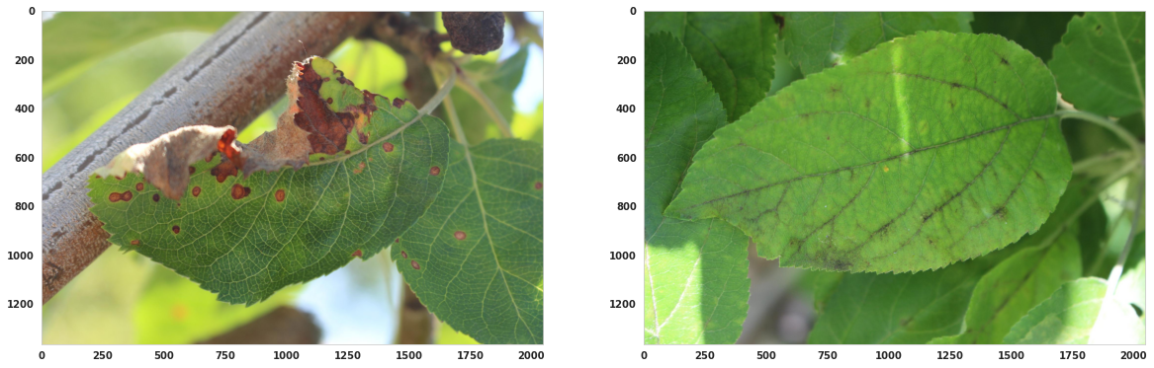
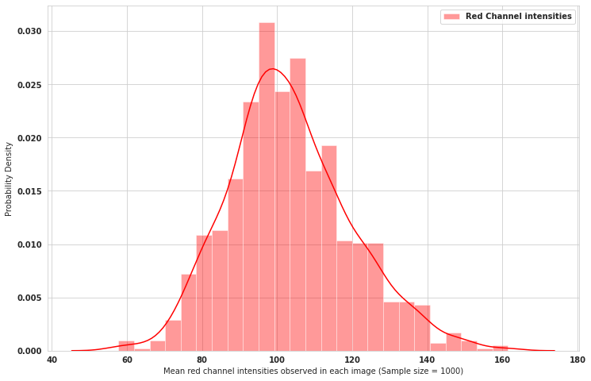
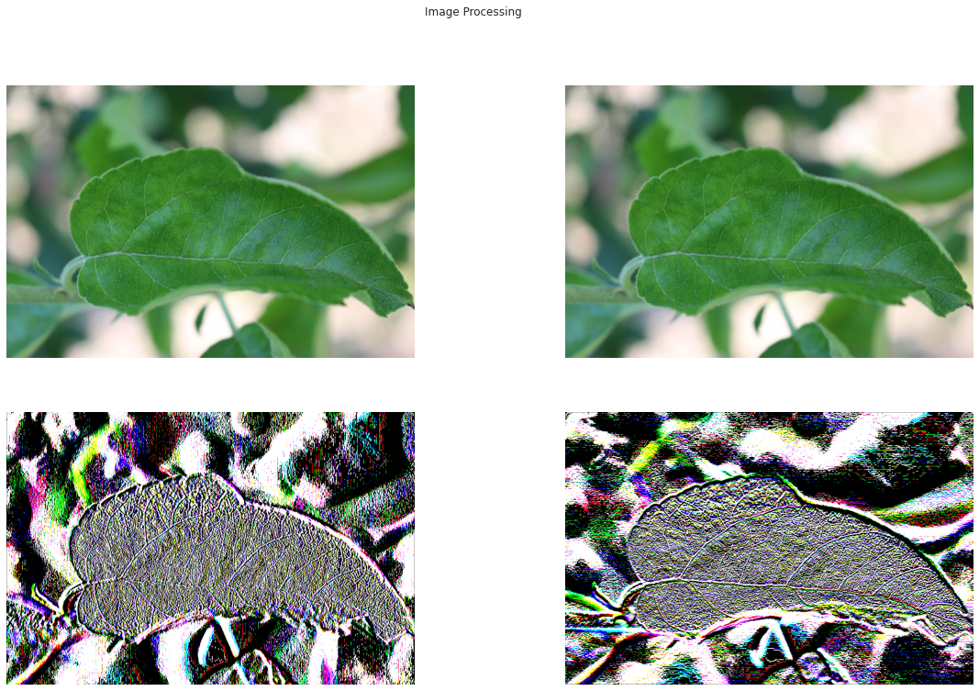
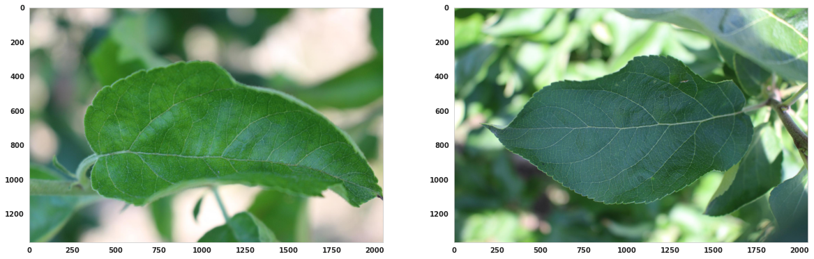
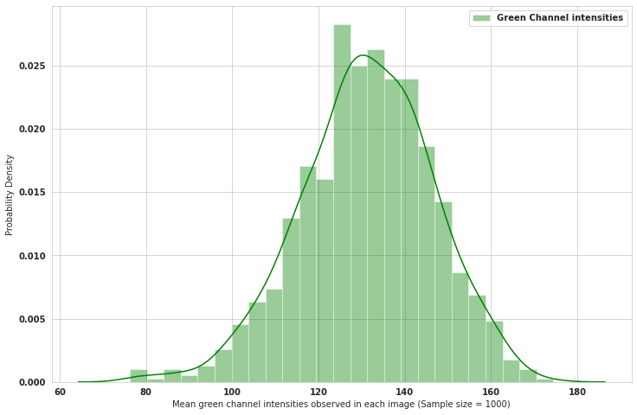
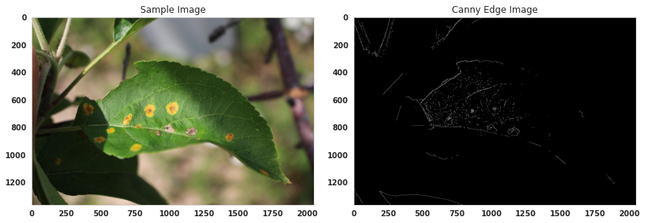
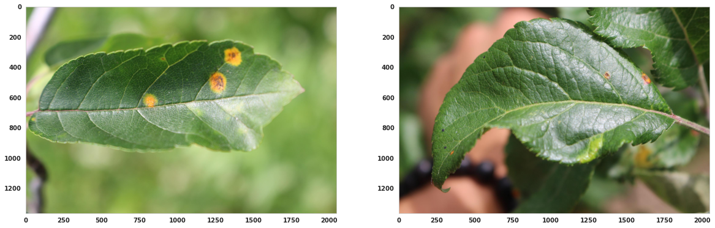
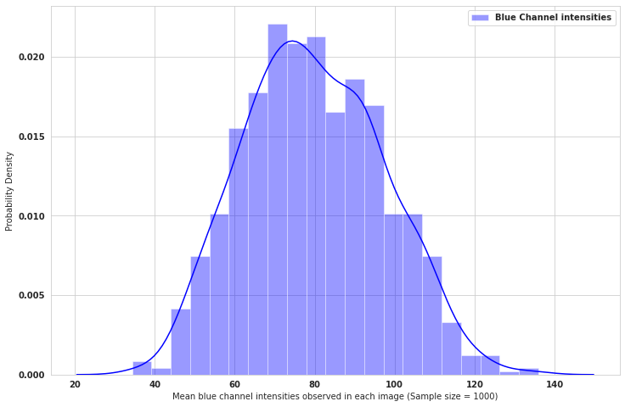
Data set acquisition
Exploratory Data Analysis
Image Processing
I
Analyzing mean values of each color channel
Image deNoising -> Sobel Filtering-> Canny Edge Image

Slide 3
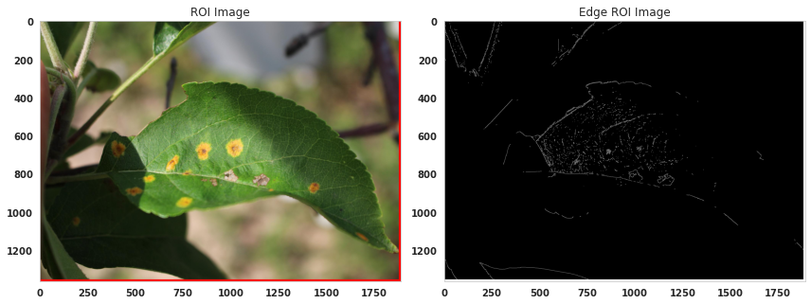
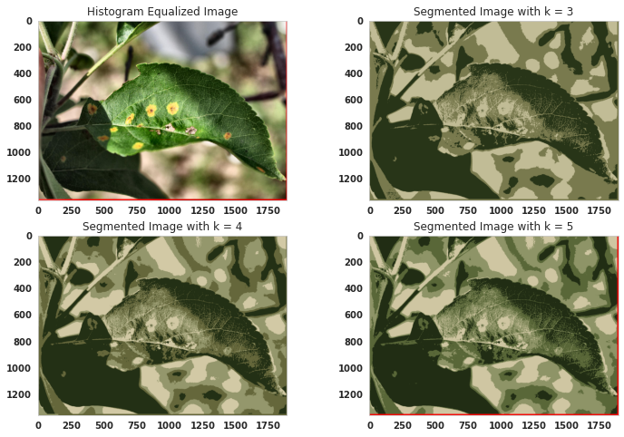

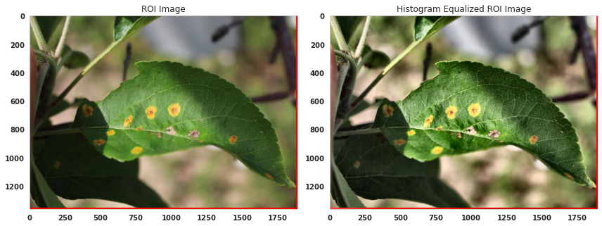
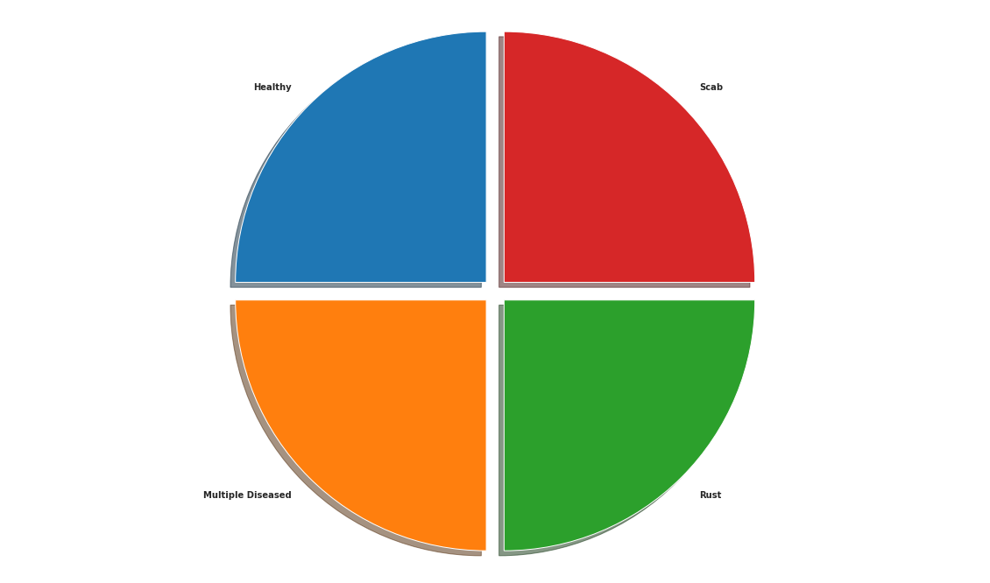
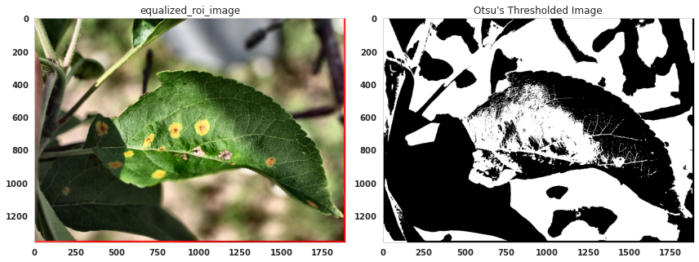

Image Processing
II
Image Processing III
&
Dataset prep
Deep Learning
With Keras framework
ROI Image -> Histogram Equalized Image-> Otsu’s Segmentation
K-means Segmentation -> SMOTE Imbalance handling-> Deep Learning Model
VGG-16

Slide 4
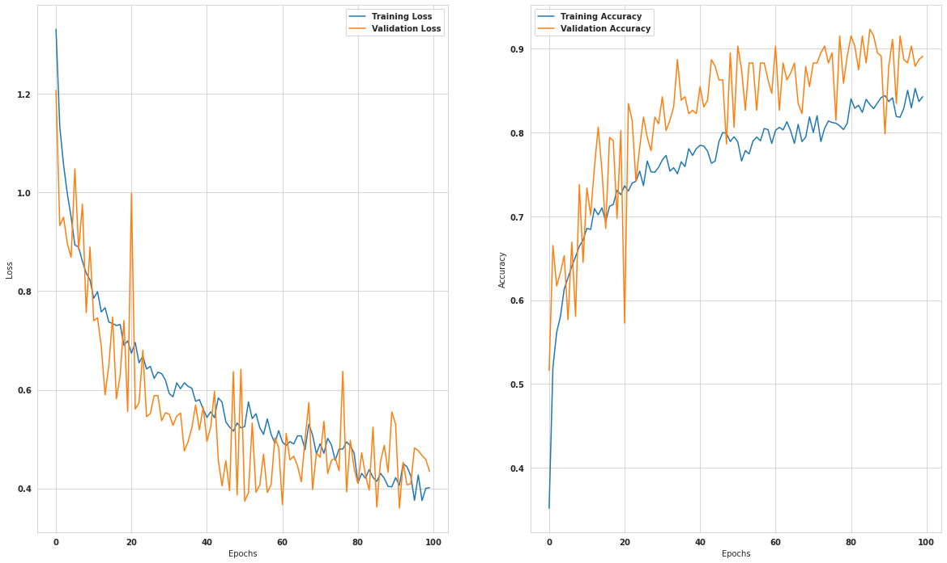
Training and Validation Result

Slide 5
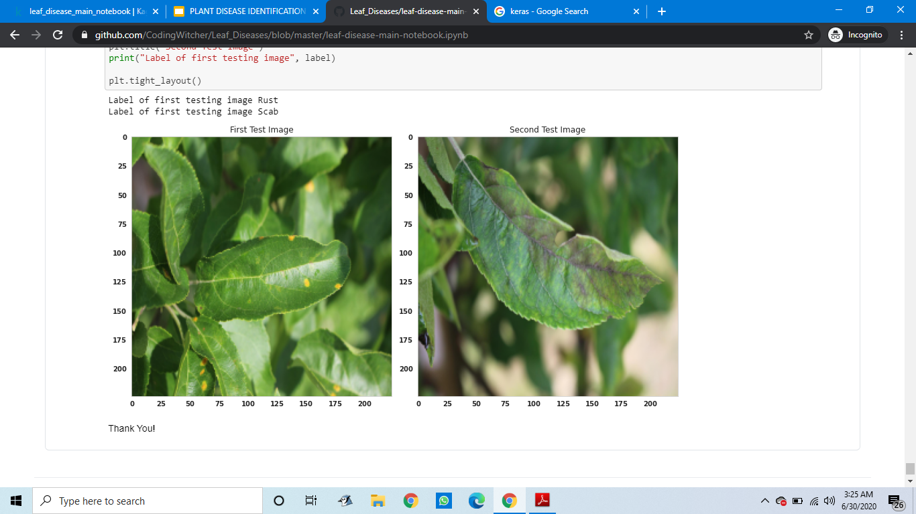
CLASSIFICATION DONE

